Slide 1
AutoRoute Navigator For Blind People Using SLAM
Done By:
Ganesh Prasad K 2019202011
MCA - R
Guide: Ms. S.Kanimozhi
Teaching Fellow

Slide 2
Problem Statement
To recognize the different type of obstacles inside a classroom
To route a visually impaired student outside/inside a classroom

Slide 3
Existing Systems
Mobile App: ZebraX app
Uses sound signal to cross zebra crossing
Low pitch => Left / Rotate
High Pitch => Right
Tone on rising scale => Indicate the Distance
Pulse of Sound => When to cross
Bluetooth Technology: Beacon
External device installed in atmosphere
Associated with an application

Slide 4
Domain
Image Processing
Neural Networks
Route Navigation

Slide 5
Technologies to be used
Language:
Python
Technologies:
OpenCV
TensorFlow
Google Colab
Algorithm:
SLAM (simultaneous localization and mapping)

Slide 6
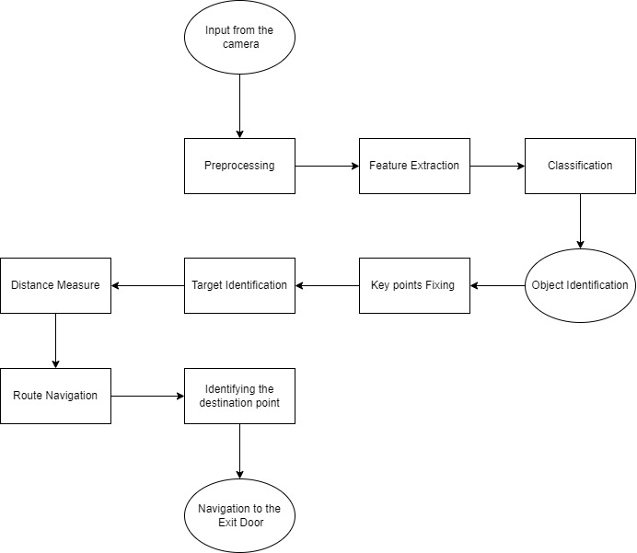
Architecture

Slide 7
Complexity
To differentiate among the obstacles inside a classroom.
For Example: To navigate a visually impaired student in/out of the class room there are many obstacle in between like chairs, benches and so on
To identify the Exit point.
Whether the door is open or close.

Slide 8
THANK YOU

